Slide 1

An Introduction To Neural Networks:
Their History, How They Work, and How to Build One Part 1 – The Perceptron
Matthew Moughtin

Slide 2
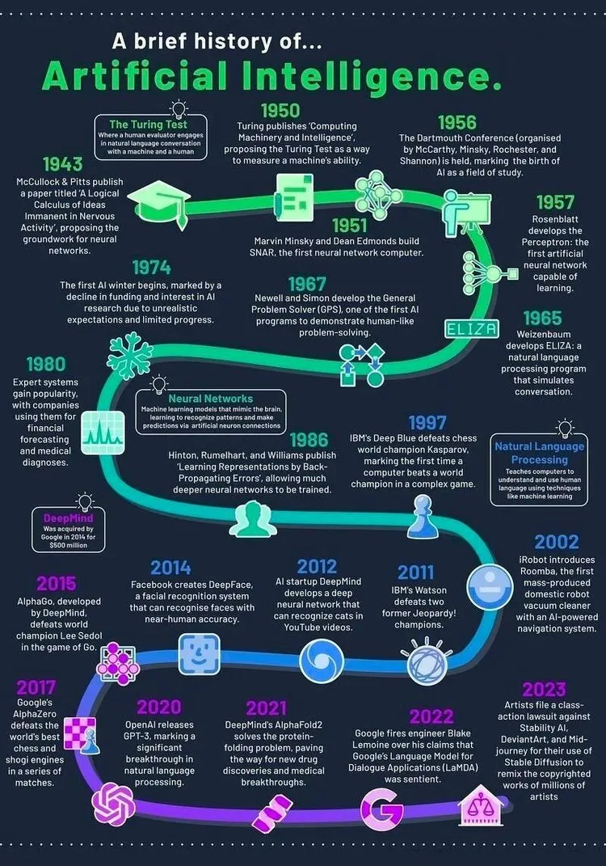
Introduction
We are going to be covering:
The history of AI
The ideas behind it.
The key people who drove the field forward.
How the various scientific developments lead to breakthroughs.
The mathematics behind it.
The functions and algorithms.
Linear algebra.
How we can create one in Python.
How to create the very first AI the Perceptron.
By the end I hope you will be able to answer these questions:
How does it work?
What can I use it for?
Image from Dr. Alvin Ang Published in DataFerns.sg
Notes:
We will be taking a journey through history. Starting at the beginning of the artificial intelligence field of study and 1943 and going up to mid-70s.
We’ll be looking at the green bits of the graphic here.
By doing this I hope to be able to show you the key people behind AI’s first conception. Their ideas and intuitions that drove the field forward. By looking at these developments in chronological order I hope you will be able to see how the ideas have built upon each-other to demystify the apparent complexity.
We will (unfortunately) be covering some mathematics, but machine learning is 90% mathematics anyway. But, don’t worry I will try and make this as painless as possible and hopefully demonstrate it in a way that will allow you to visualise how it works and understand it on an intuitive level (even if you’re not able to derive the solutions yourself).
With this knowledge I will show you how you can create your own Neural networks in python starting with the very first neural network know as a Perceptron.
By the end of this I hope you will all understand how AI works, and lastly what are the practical uses, how might you use them?

Slide 3

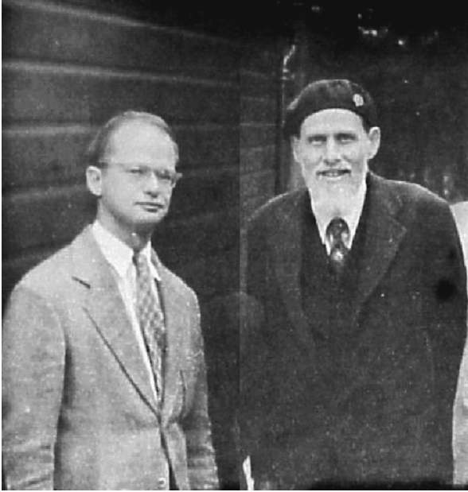
The Invention of the Artificial Neuron Network – McCulloch & Pitts
Warren McCulloch – neurophysiologist and cybernetician.
Walter Pitts – Logician and cognitive psychologist.
1943 Paper – A logical calculus of the ideas immanent in nervous activity.
Provided a way to describe brain functions and showed simple elements connected in a neural network can have immense computational power.
Used a binary step activation function to show a neuron turning on and off.
As a legacy of their work artificial neurons are sometimes referred to as McCulloch-Pitts neurons.
McCulloch (right) & Pitts (left)
Notes:
Starting at the beginning. The invention of the Artificial Neuron Network.
By these two gentlemen on the right.
McCulloch was a neurophysiologist and cybernetician and Pitts was a logician and cognitive psychologist.
Going to notice a pattern of the key players. A lot of neurologists and mathematicians. But, not many computer scientists because it is a very different field!
Built upon and was inspired by Alan Turing’s work (father of modern computer science), later known the Turing Test which is the foundation of the artificial intelligence field. Won’t talk much about it because it is so famous I am sure everyone is aware of it. If not, go watch the movie about him. Also not massively relevant for what we will be looking at here.
Paper in 1943 was published in the The Bulletin of Mathematical Biophysics.
McCulloch and Pitts work viewed neurons as logic gates (AND, OR, NOT). Representing Neuron firings as a binary on/off logic.
Artificial neurons using their methods are still sometimes today referred to as McCulloch-Pitts neurons.

Slide 4
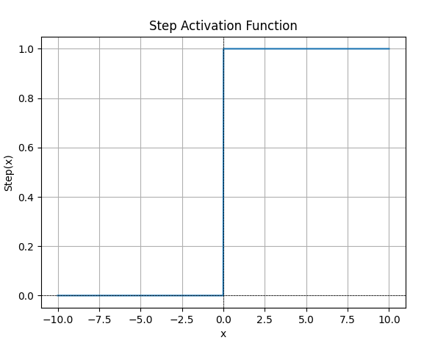
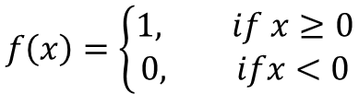
Activation Functions - Step
$$f\left(x\right)=\left\{\begin{aligned}1, if x≥0 \\ &0, ifx<0\end{aligned}\right.$$
Activation functions are used to transform the input of the neuron to an output that can be fed to the next layer.
Think of it like the mathematical description of a neuron firing or not firing.
If the value is greater than 0 output 1.
If the value is less than 0 output 0.
Allows us to have a binary output of on/off for our neurons.
Notes:
Our first bit of maths! Don’t worry it is very simple.
This is the step activation function I mentioned earlier used by McCulloch and Pitts. This is how that step function is written and this is how it looks when graphed. I graphed it in Python here.
Activation functions are extremely important and foundational when talking about neural networks. These are the literal mathematical representation of a neuron firing.
Having mathematical representations of physical processes that are happening is going to be extremely important, this is how we can model the physical behaviour and how we can ultimately program it into python.
In this case either a neuron fires or it does not fire, that is what this function is showing.
This activation function is going to transform the input it is given to a new output that can be fed to the next layer of a neural network. In this case if the input value is greater that 0 the output is 1 (i.e. the neuron has fired). Conversely if the input value is less than 0 the output is 0 (i.e. the neuron has not fired).

Slide 5
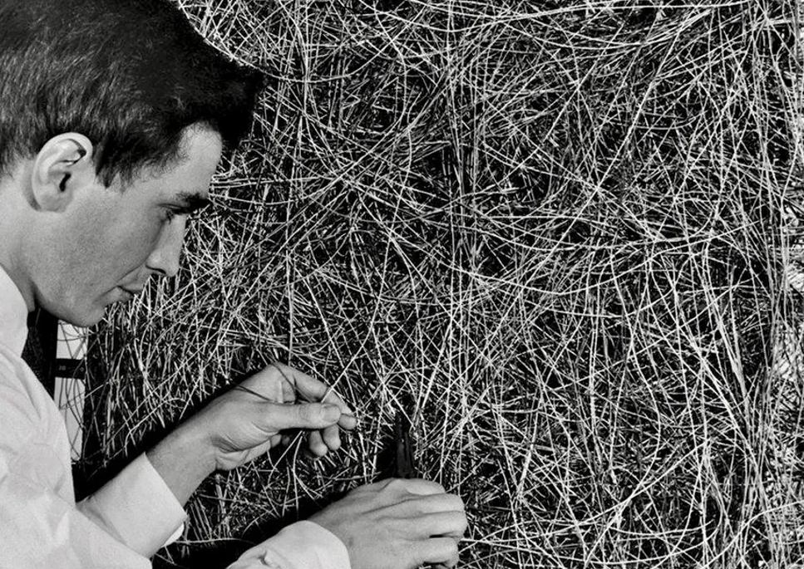
Frank Rosenblatt and the Perceptron
Rosenblatt a psychologist working at the Cornell Aeronautical Laboratory (USA).
1957 – build the first neural network capable of learning called the Perceptron.
Able to recognize patterns automatically.
Shocked the world. The New York Times wrote that it might one day be able to “walk, talk, see, write, reproduce itself, and be conscious of its existence.
Laid the groundwork for today’s modern neural networks.
Notes:
Now we have the maths out the way we can look at the next big development.
This is Frank Rosenblatt, before the invention of cable management (I think).
He was a psychologist working at the Cornell Aeronautical Laboratory trying to build a physical working model of the previous mathematical models developed.
In 1957 he shocked the world when he built the first ever neural network capable of learning on its own and automatically recognize patterns called the Perceptron.
One of his big developments was known as the Rosenblatt rule which was the mechanism the Perceptron used in order to learn. We will look at this in a few slides.
The New York Times wrote that it might one day be able to walk, talk, see, write, reproduce itself, and maybe even be conscious of its existence. Pretty amazing foresight given what we have today.
I am (hopefully) going to be teaching you how you could build your own Perceptron today.

Slide 6
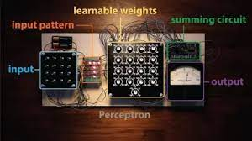


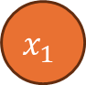

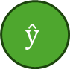
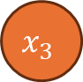
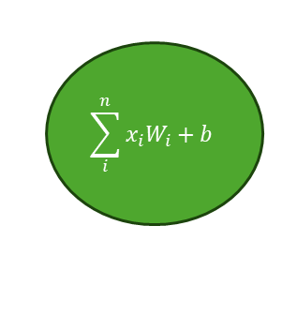
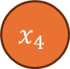

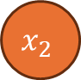

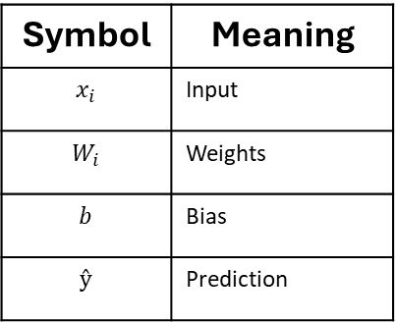
The Perceptron Neural Network Architecture
Symbol | Meaning
$$x_{i}$$ | Input
$$W_{i}$$ | Weights
$$b$$ | Bias
$$ŷ$$ | Prediction
$$b$$
$$x_{1}$$
$$W_{1}$$
Takes the inputs.
Inputs multiplied by weights.
Bias is added.
Activation function determines if the output is on or off.
Weights and bias is adjustable.
Weighted sum
$$x_{2}$$
$$W_{2}$$
$$\sum_{i}^{n}{x_{i}W_{i}}+b$$
Activation Function
$$ŷ$$
$$x_{3}$$
$$W_{3}$$
$$x_{4}$$
$$W_{4}$$
Notes:
This is a simplified look at the architecture of Rosenblatt’s Perceptron Neural Network.
Rosenblatt’s original Perceptron had 400 input neurons. Mine here has only four. But, the concept is identical even if the scale is not.
What this is doing on an intuitive level is you give it some input (like numbers or features), and it looks at those inputs, gives each one a level of importance (called weights), and adds a little extra push (called bias). Then it combines everything and decides whether to "activate" or not. The result is the network's prediction.
You take your inputs and you then multiply them by some weights (the weights can be any random number to begin with). On the image in the top left the weights are show as dials and this is a very good way to think of the weights. They are very literally dials that you can turn and tune to get the output you want.
The weights are summed along with an additional bias input.
Those sum is then put through the activation function we talked about afterwards and then a prediction is made.
Note – The symbols I am using here are important. They will be used in the code later, and I am using the standard and typical symbols used to describe these things that are used when building neural networks.
If someone asks about the bias:
Bias helps shift the decision boundary away from the origin so it can classify data that isn’t passing through the origin.
Acting like an intercept in a linear equation like y = x + b.
A bias is needed to help the perceptron fire or not fire even when all inputs are zero.
The extra parameter of the bias helps to increase the model’s ability to fit and classify data correctly.

Slide 7
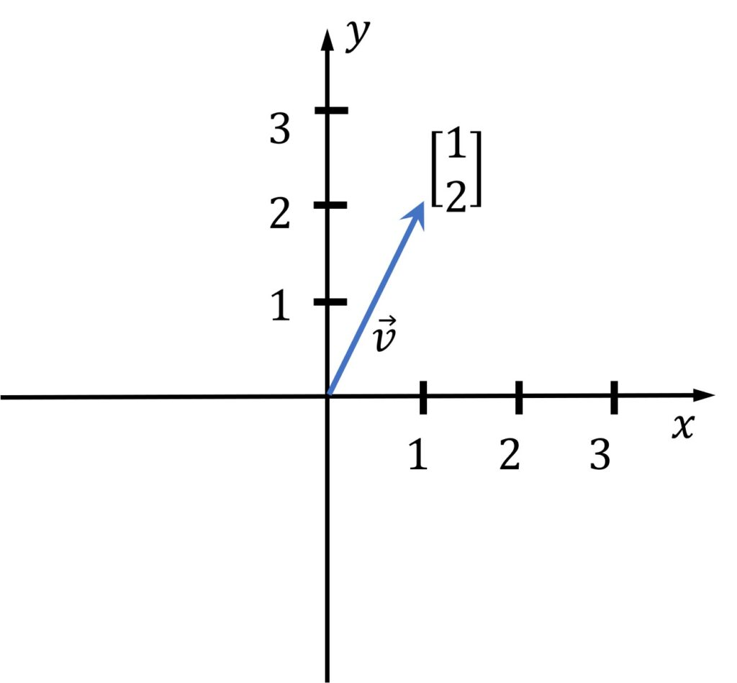
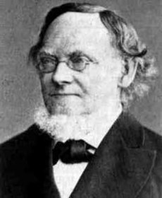

Some Maths - Linear Algebra
Study of vectors, matrices, tensors.
Can visualise these to help explain them.
Simple vector demonstrated here on the right.
Hopefully familiar with everyone as arrays.
Herman Günther Grassmann.
Notes:
Now we are going to look at some more maths: Linear algebra – Sounds intimidating, but those familiar with it will know it is actually really really easy. Just a bit fiddley and annoying.
This is actually a really core concept you need to grasp if you have any chance of building a neural network yourself. If you can’t get to grips with this don’t bother trying to build a neural network.
That is because 90% of the issues you will have in your code will because of mistakes in the maths of this. I myself spent many a late night trying to debug matrix dimensions whilst writing the neural networks we will demonstrate later.
Created by the guy picture here, Hermann Grassmann in 1844. Just for fun, they knew of no practical use of it at the time. Anyway, you can blame him for making you look at some maths now.
It is a branch of mathematics concerned with studying vectors matrices, and linear transformations.
What is that you ask? It’s basically mathematical representations of geometries. Which is good, because instead of having to look at too much maths we can visualise it to explain it. This is a very physicsy way of understanding vectors (but that’s my background).
On the right here we have a simple vector 1 in the x dimension and 2 in y dimension. And that is how you can try to visualise them in a geometric space.
Hopefully everyone is pretty familiar with these anyway as we use them in programming and scripting as arrays. A list of numbers. This would be a computer scientist way to think of them.

Slide 8
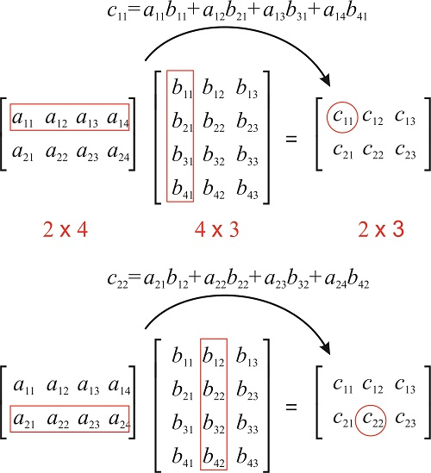
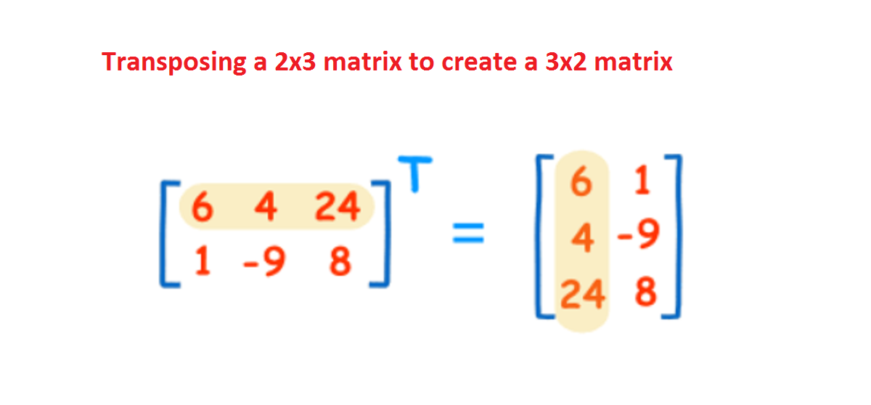
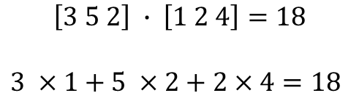
Linear Algebra – Multiplication, Dot Product, and Transpose
Dot product is measuring how aligned a tensor is.
Multiplying each row of the tensor and then add the results up.
$$\left[3 5 2\right] ∙ \left[1 2 4\right]=18$$
$3 ×1+5 ×2+2×4=18$
Transposing a tensor, you’re just flipping it over its diagonal.
Multiplication of a tensor is taking the Dot Product of Rows and Columns, multiply each element of a row in the first matrix by the corresponding element of a column in the second matrix, then sum the results to get one element in the result matrix.
Dimension Rule: You can multiply two matrices A (m×n) and B (n×p) only if the number of columns in A equals the number of rows in B. The result is a new matrix of size (m×p).
Notes:
There are some useful properties and manipulations we can perform on tensors that we will look at now. I probably Hopefully, spend too long going through these as its probably going to bore most people. However, I have left it all here as a reference if anyone wants to try having a go at building a neural network themselves.
First, on the left we have the simplest and easiest to understand. This is Transposing a tensor. Its just flipping the matrix over its diagonal. In the example in the image a 2 by 3 matrix is transposed (or flipped over its diagonal) to a 3 by 2 matrix.
You may be thinking, what is the point of that? Well hopefully you will see very shortly how it could be very useful for us.
In the middle we have the dot product. What this is doing is measuring how aligned a tensor is, whether they are pointing in the same direction.
To take the dot product you multiply each row and then add up the results. A large positive number like in the example means they are pointing in similar directions.
Multiplication is a bit more complicated. You multiply each row in the first tensor with the corresponding column in the second, then sum the results to get one element of the final matrix.
There is one special rule which is the dimension rule. You can only multiply the matrices if the number of columns in the first matrix equals the number of rows in the second resulting in a final matrix with columns equal to the first matrix and rows equal to the second.
Hopefully that shows you why transposing a matrix is useful.
If you’re going to have a go a trying to build your own neural networks then I really suggest you spend some time trying to learn and understand these concepts. I can tell you from first hand experience that 90% of the issues I had with my code building these was down to issues with my matrix dimensions and the math not working.

Slide 9
Creating the Perceptron Architecture in Python
import numpy as np
# Step 1: Create network architecture
L = 1
n = [4, 1] # Only input layer and output layer
print("layer 0 / input layer size", n[0])
print("layer 1 / output layer size", n[1])
# Step 2: Initialize weights and bias
W = np.random.randn(n[1], n[0]) # shape: (1, 4)
b = np.random.randn(n[1], 1) # shape: (1, 1)
print("Weights shape:", W.shape)
print("Bias shape:", b.shape)
Notes:
Now lets start looking at building up the code to build our Perceptron.
First we’re going to construct the architecture that we looked at a few slides back.
We’re using numpy for array computing and we’ll start by importing that.
First step is to define the architecture of One layer and 4 neurons.
Second step is to create some weights and biases. Just using some random numbers to do that.
Pretty simple bit of code to start us off.

Slide 10
Training Data - The Four Golden Signals
Latency | Traffic | Errors | Saturation | At Risk
100 | 200 | 1 | 60 | N
300 | 500 | 4 | 90 | Y
120 | 180 | 0 | 50 | N
400 | 600 | 7 | 95 | Y
150 | 250 | 2 | 65 | N
250 | 450 | 5 | 85 | Y
110 | 190 | 0 | 55 | N
350 | 550 | 6 | 92 | Y
130 | 220 | 1 | 62 | N
280 | 480 | 4 | 88 | Y
Four metrics chosen to give complete system health. How your system is performing, how much it is doing, how often it fails, and how close to the limits it is.
Our network architecture needs to match the number of parameters of the data we are analysing.
Notes:
Next we need something to train our network on. A sample of the data we are trying to analyse.
The thing I picked for us to analyse is something for our SREs out there. The four golden signals.
Recap of what these are for those unfamiliar - Four metrics chosen to give a complete view of system health. They consist of:
Latency to tell you how well your system is performing.
Traffic to show you how much you system is doing.
Errors to show you how often your system is failing.
Saturation to show how close to system limits you are.
The size of the input neurons of your neural network needs to match the data you are analysing. So now it makes sense why I chose four neurons.
The data here is what is know in data engineering as synthetic. Which means, I made it up.

Slide 11
Creating Some Training Data – The Four Golden Signals
# Step 3: Create training data and labels
def prepare_data():
X = np.array([
[100, 200, 1, 60], # OK
[300, 500, 4, 90], # At risk
[120, 180, 0, 50], # OK
[400, 600, 7, 95], # At risk
[150, 250, 2, 65], # OK
[250, 450, 5, 85], # At risk
[110, 190, 0, 55], # OK
[350, 550, 6, 92], # At risk
[130, 220, 1, 62], # OK
[280, 480, 4, 88] # At risk
])
y = np.array([0, 1, 0, 1, 0, 1, 0, 1, 0, 1])
m = X.shape[0]
# We need the matrix transposed as we will pass the data to the neural network in this rotation.
# Use the .T property to do this.
A0 = X.T # shape: (4, 10)
#.reshape on a matrix allows for it to be reshaped. y is a vector,
# but we want it as a matrix Y to match the output of our network.
Y = y.reshape(n[L], m) # shape: (1, 10)
return A0, Y
Notes:
The next step in our code is to create the training data that we just looked at on the previous slide.
Going to feed the data into an array.
As well as creating a second array for the expected result of the data. Are the four golden signals indicating a system at risk or not.
We do need to reshape the arrays. The input data matrix needs to be transposed (hey we learned about that earlier!).
We need to turn y which is a vector into a matrix as well.

Slide 12
Activation Function and Feeding the Training Data to the Network
# Step 4: Activation function (step)
def step(arr):
return np.where(arr > 0, 1, 0) # Step activation function
# Step 5: Feed forward process
def feed_forward(A0):
Z = W @ A0 + b # Linear combination of inputs and weights, plus bias
A = step(Z) # Apply activation function
return A # Return the output of the perceptron
Notes:
Next we’re defining the activation function. Step four is just writing that step activation function into code.
The next step in our code is to feed the data into the perceptron. This is called the Feed Forward process. The feed forward process is how a neural network makes a decision.
You give it the input, it looks at those inputs, gives each one a level of importance with the weights. Then adds this bias. Then it combines everything and decides whether to "activate" or not. The result is the network's prediction.
As you may have figured out. This is probably not a very good way to make a prediction. Earlier on we assigned the weights and biases random numbers. In effect giving all the neurons random importance. That’s going to end in completely random predictions. So we need a way to improve the predictions.

Slide 13
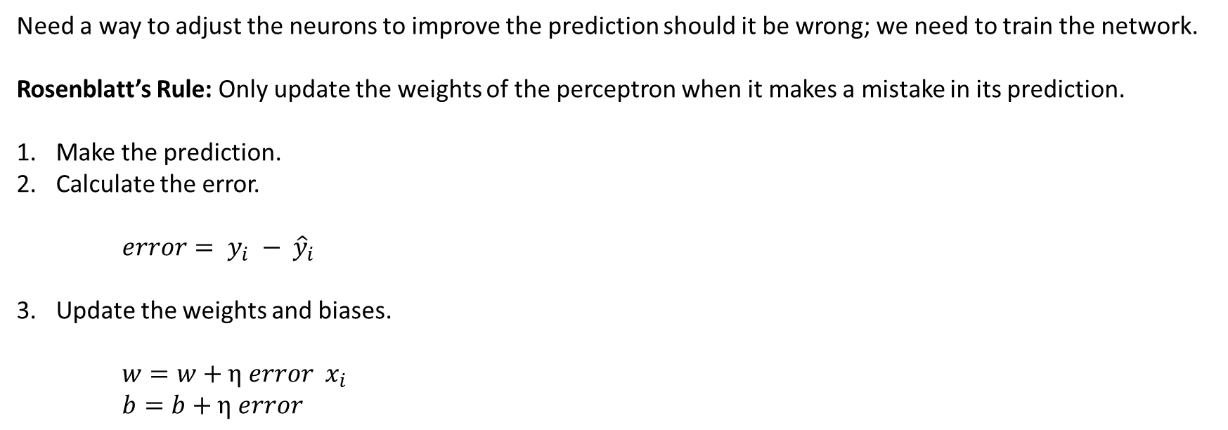
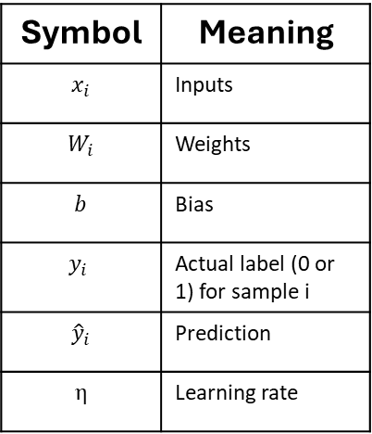
Training the Network Using Rosenblatt’s Rule
Need a way to adjust the neurons to improve the prediction should it be wrong; we need to train the network.
Rosenblatt’s Rule: Only update the weights of the perceptron when it makes a mistake in its prediction.
Make the prediction.
Calculate the error.
$error= y_{i} − {\hat{y}}_{i}$
Update the weights and biases.
$w=w+\text{η} error x_{i}$
$b=b+\text{η} error$
Symbol | Meaning
$$x_{i}$$ | Inputs
$$W_{i}$$ | Weights
$$b$$ | Bias
$$y_{i}$$ | Actual label (0 or 1) for sample i
$${\hat{y}}_{i}$$ | Prediction
$$\text{η}$$ | Learning rate
Prediction Result | Error | Effect
Prediction is correct | 0 | No Update
Predicts 0 but should be 1 | +1 | Weight increase in the direction of x
Predicts 1 but should be 0 | -1 | Weight decrease in the direction of x
Notes:
Well Rosenblatt figured out a way to improve the predictions. Taking inspirations from real brains and intelligence the neural network is trained. In the exact way we learn things, we get something wrong, we learn the correct things, we learn. This is exactly what Rosenblatt attempted with his Perceptron.
Rosenblatt’s rule defines how the perceptron is trained. Essentially when it makes a mistake in its prediction the weights of the perceptron are updated.
The weights and biases need to be updated in the opposite direction of the wrong prediction it makes.
There error will be multiplied by a learning rate before updating the new weightings/bias. The learning weight is an important metric that tells us how much to update the weights and biases. Essentially a scaling factor for the weights and biases. Without it the updates could be too large making the learning chaotic and unstable.

Slide 14
Creating the Training loop with Rosenblatt’s Rule
# Step 6: Training loop using Rosenblatt’s rule
def train(A0, Y, epochs=10, learning_rate=0.01):
global W, b # Allow updates to the global weights and bias
m = A0.shape[1] # Number of training examples
for epoch in range(epochs):
for i in range(m):
# Extract the i-th training example and label
x_i = A0[:, i].reshape(n[0], 1) # Shape: (4, 1) — column vector for single input
y_i = Y[0, i] # Shape: scalar — expected output (0 or 1)
# Forward pass for a single example
z_i = W @ x_i + b # Weighted sum (dot product + bias), shape: (1, 1)
a_i = step(z_i) # Apply step activation → prediction (0 or 1), shape: (1, 1)
# Calculate error between predicted and actual value
error = y_i - a_i # If prediction is wrong, error will be ±1
# Update weights and bias according to the perceptron learning rule:
# w = w + learning_rate * error * input
# b = b + learning_rate * error
W += learning_rate * error * x_i.T # x_i.T shape: (1, 4), so W shape stays (1, 4)
b += learning_rate * error # Adjust bias (broadcast to shape (1, 1))
print(f"Epoch {epoch+1} complete") # Notify when each epoch is done
Notes:
The final step is for us to create a training loop using Rosenblatt’s rule.
In effect what we are doing is continually getting the perceptron to make predictions then updating the weights and biases after each forward pass of the data until eventually it has learned the patterns in the data.
We’re using a loop to get the perceptron to make a prediction then for us to update the weights and biases and then repeat this process.

Slide 15
Bring it all Together to Create Our Perceptron
import numpy as np
# Step 1: Create network architecture
L = 1
n = [4, 1] # Only input layer and output layer
print("layer 0 / input layer size", n[0])
print("layer 1 / output layer size", n[1])
# Step 2: Initialize weights and bias
W = np.random.randn(n[1], n[0]) # shape: (1, 4)
b = np.random.randn(n[1], 1) # shape: (1, 1)
print("Weights shape:", W.shape)
print("Bias shape:", b.shape)
# Step 3: Create training data and labels
def prepare_data():
X = np.array([
[100, 200, 1, 60], # OK
[300, 500, 4, 90], # At risk
[120, 180, 0, 50], # OK
[400, 600, 7, 95], # At risk
[150, 250, 2, 65], # OK
[250, 450, 5, 85], # At risk
[110, 190, 0, 55], # OK
[350, 550, 6, 92], # At risk
[130, 220, 1, 62], # OK
[280, 480, 4, 88] # At risk
])
y = np.array([0, 1, 0, 1, 0, 1, 0, 1, 0, 1])
m = X.shape[0]
A0 = X.T # shape: (4, 10)
Y = y.reshape(n[L], m) # shape: (1, 10)
return A0, Y
# Step 4: Activation function (step)
def step(arr):
return np.where(arr > 0, 1, 0)
# Step 5: Feed forward function
def feed_forward(A0):
Z = W @ A0 + b
A = step(Z)
return A
# Step 6: Training loop using Rosenblatt’s rule
def train(A0, Y, epochs=20, learning_rate=0.01):
global W, b # Allow updates to the global weights and bias
m = A0.shape[1] # Number of training examples
for epoch in range(epochs):
for i in range(m):
# Extract the i-th training example and label
x_i = A0[:, i].reshape(n[0], 1) # Shape: (4, 1) — column vector for single input
y_i = Y[0, i] # Shape: scalar — expected output (0 or 1)
# Forward pass for a single example
z_i = W @ x_i + b # Weighted sum (dot product + bias), shape: (1, 1)
a_i = step(z_i) # Apply step activation → prediction (0 or 1), shape: (1, 1)
# Calculate error between predicted and actual value
error = y_i - a_i # If prediction is wrong, error will be ±1
# Update weights and bias according to the perceptron learning rule:
# w = w + learning_rate * error * input
# b = b + learning_rate * error
W += learning_rate * error * x_i.T # x_i.T shape: (1, 4), so W shape stays (1, 4)
b += learning_rate * error # Adjust bias (broadcast to shape (1, 1))
print(f"Epoch {epoch+1} complete") # Notify when each epoch is done
# Call functions
A0, Y = prepare_data()
train(A0, Y, epochs=20, learning_rate=0.01)
y_hat = feed_forward(A0)
print("Predictions (y_hat):")
print(y_hat)
print("Actual (Y):")
print(Y)
The model’s predictions y_hat after 20 training epochs:
[[0 1 0 1 0 1 0 1 0 1]]
Actual training data (Y):
[[0 1 0 1 0 1 0 1 0 1]]
100% success rate!
Notes:
Now we’ll bring all the code together we previously went through and call the functions and print the outputs.
We’ve done it, we have built our first neural network the Perceptron.
I ran the training of this network with 20 loops and it gave me a 100% success rate on predicting the training data.

Slide 16

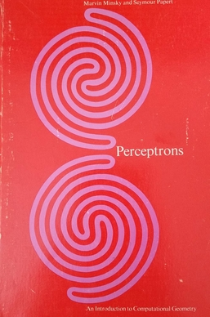
First AI Winter
Problems with the perceptron.
Unable to solve XOR logic function.
Unable to distinguish connectedness predicates.
Progress of AI development was slower than hoped.
Death of Frank Rosenblatt.
Notes:
There were some problems with the Perceptron with criticisms outlined in a somewhat controversial book by Marvin Minsky and Seymour Papert.
It is unable to solve the Boolean exclusive-or problem (or XOR).
Unable to distinguish connectedness predicates. Which is a fancy mathematical way to say that it can’t determine whether two elements are connected. The image on the cover of the book illustrates this, with the perceptron being unable to tell the two images apart. One consists of two lines, the other of a single line. AI development was slower than was hoped as expectations were very high.
The sad death of Frank Rosenblatt on his 43rd birthday in 1971 who was working on a multi-layered neural network that would have overcome the problems of the original Perceptron.
These things combined led to a decline in AI research and funding in what has retrospectively become known as the first AI winter.
Next time we will look at the developments that eventually led to the development of multi-layer neural networks, and again how to build one of those.

Slide 17

Questions & Answers

